Slide 1
Network Virtualization
Student: Colban Mihai – ISS 2

Slide 2
What is Network Virtualization?
It is the process of combining hardware and software network resources and functionality into a single, software-based administrative entity.
Creating multiple virtual networks on a physical network.
Each virtual network has a illusion as it is running as a physical network.
Virtualizing a network divides the bandwidth into independent channels.

Slide 3
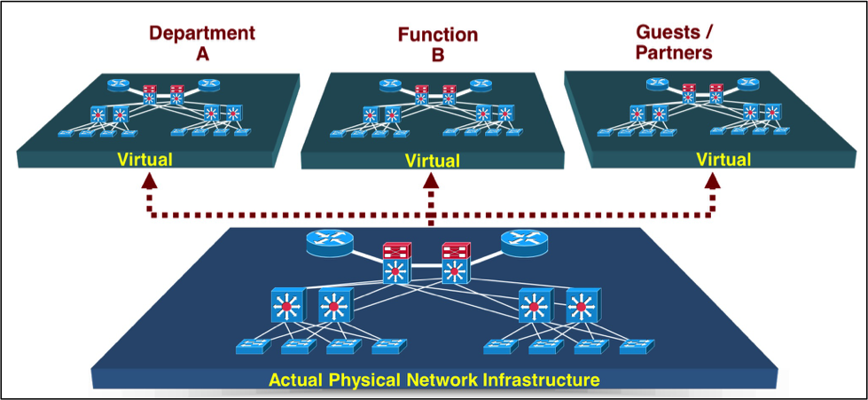

Slide 4
Applications of Virtualization
Traffic isolation in enterprise and campus networks
VLANs
Secure private networks operating across wide areas
VPNs
Multi-tenant datacenters

Slide 5
Application Examples of Network Segmentation in Individual Verticals
 | Examples of Cases for Network Virtualization
Manufacturing | Production plants (robots, automation of production environment, and so on), administration, sales, video surveillance.
Finance | Trading floors, administration, mergers.
Government | Shared buildings and facilities supporting different departments. In some countries the law mandates separate networks between such departments.
Healthcare | General trend toward hotel service with medical treatment. Separation among medical staff, magnetic resonance imaging (MRI) and other technical equipment, Internet access for patients, media services such as radio and television for patients.
Commercial Real Estate: Multibusiness Campus | Some resources are shared among groups. Multiple companies on the same campus where different buildings belong to different groups, but all rely on the same core and Internet access. Building automation is administered by the owner and spans across all buildings.
Retail | Kiosks, public wireless LAN (PWLAN) in branches, RF identification, WLAN devices (for example, older WLAN barcode readers that do not support any WLAN security).
Education | Separation among students, professors, administrators, and external research groups. Alternatively, individual departments that spread across multiple buildings might require access to their respective server areas. Some resources (Internet, e-mail, and news, for example) might be shared or accessed through a services zone. Building automation, too, must be separated.

Slide 6
Features Of Network Virtualization
Partitioning: Network virtualization allows creation of multiple logical network with a programmable control plane.
Isolation : there is no interference among the virtual networks.
Abstraction : Network abstraction allows hiding the underlying characteristics of network elements .
Aggregation : Provide high performance resources for users by logically aggregating multiple resources into single resource

Slide 7
Advantages of network virtualization
Infrastructure utilization:
Virtual network is shared between many different users or purposes and thus reduces infrastructure and energy cost
Scalability:
Easy to extend resources in need, Administrator can dynamically create or delete resources.
Agility:
Enables automation of network services establishment
Security:
Increase data traffic isolation and user segmentation
Virtual network should work with firewall software

Slide 8
Network virtualization methods
IEEE 802.1q
NVGRE
VXLAN
MPLS

Slide 9
IEEE 802.1q
is the networking standard that supports virtual LANs (VLANs) on an Ethernet network. The standard defines a system of VLAN tagging for Ethernet frames and the accompanying procedures to be used by bridges and switches in handling such frames
Portions of the network which are VLAN-aware can include VLAN tags. When a frame enters the VLAN-aware portion of the network, a tag is added to represent the VLAN membership of the frame's port or the port/protocol combination, depending on whether port-based or port-and-protocol-based VLAN classification is being used. Each frame must be distinguishable as being within exactly one VLAN. A frame in the VLAN-aware portion of the network that does not contain a VLAN tag is assumed to be flowing on the native VLAN

Slide 10
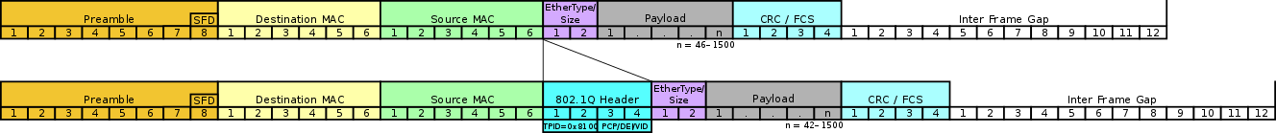
IEEE 802.1q
802.1Q does not encapsulate the original frame. Instead, for Ethernet frames, it adds a 32-bit field between the source MAC address and the EtherType/length fields of the original frame, leaving the minimum frame size unchanged at 64 bytes (octets) and extending the maximum frame size from 1,518 bytes to 1,522 bytes

Slide 11
NVGRE - Network Virtualization using Generic Routing Encapsulation
NVGRE (Network Virtualization using Generic Routing Encapsulation) is a network virtualization method that uses encapsulation and tunneling to create large numbers of virtual LANs (VLANs) for subnets that can extend across dispersed data centers and layer 2 (the data link layer) and layer 3 (the network layer). The purpose is to enable multi-tenant and load-balanced networks that can be shared across on-premises and cloud environments.

Slide 12
NVGRE - Network Virtualization using Generic Routing Encapsulation
NVGRE was designed to solve problems caused by the limited number of VLANs that the IEEE 802.1Q specification enables (4094-4096 VLANs), which are inadequate for complex virtualized environments, and make it difficult to stretch network segments over the long distances required for dispersed data centers.

Slide 13
NVGRE - Network Virtualization using Generic Routing Encapsulation
The NVGRE specification was proposed by Microsoft, Intel, HP and Dell.
NVGRE competes with another encapsulation method, VXLAN (Virtual Extensible LAN).

Slide 14
VXLAN (Virtual Extensible LAN)
Virtual Extensible LAN (VXLAN) is a proposed encapsulation protocol for running an overlay network on existing Layer 3 infrastructure. An overlay network is a virtual network that is built on top of existing network Layer 2 and Layer 3 technologies to support elastic compute architectures. VXLAN will make it easier for network engineers to scale out a cloud computing environment while logically isolating cloud apps and tenants.

Slide 15
VXLAN (Virtual Extensible LAN)
A cloud computing architecture is by definition, multi-tenant; each tenant requires its own logical network, which in turn, requires its own network identification (network ID). Traditionally, network engineers have used virtual LANs (VLANs) to isolate apps and tenants in a cloud computing environment but VLAN specifications only allow for up to 4,096 network IDs to be assigned at any given time -- which may not be enough addresses for a large cloud computing environment.
The primary goal of VXLAN is to extend the virtual LAN (VLAN) address space by adding a 24-bit segment ID and increasing the number of available IDs to 16 million. The VXLAN segment ID in each frame differentiates individual logical networks so millions of isolated Layer 2 VXLAN networks can co-exist on a common Layer 3 infrastructure. As with VLANs, only virtual machines (VMs) within the same logical network can communicate with each other.

Slide 16
MPLS - Multiple Protocol Label Switching
is a type of data-carrying technique for high-performance telecommunications networks that directs data from one network node to the next based on short path labels rather than long network addresses, avoiding complex lookups in a routing table.
MPLS is a scalable, protocol-independent transport. In an MPLS network, data packets are assigned labels. Packet-forwarding decisions are made solely on the contents of this label, without the need to examine the packet itself. This allows one to create end-to-end circuits across any type of transport medium, using any protocol. The primary benefit is to eliminate dependence on a particular OSI model data link layer (layer 2) technology, such as Asynchronous Transfer Mode (ATM), Frame Relay, Synchronous Optical Networking (SONET) or Ethernet, and eliminate the need for multiple layer-2 networks to satisfy different types of traffic

Slide 17
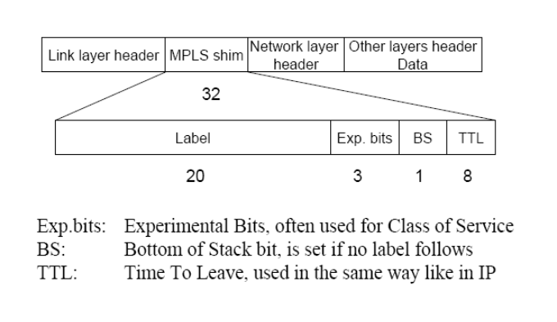
Label
Generic label format

Slide 18
MPLS Advantages
Improves packet-forwarding performance in the network
Supports QoS and CoS for service differentiation
Supports network scalability
Integrates IP and ATM in the network
Builds interoperable networks

Slide 19
MPLS Disadvantages
An additional layer is added
The router has to understand MPLS

